Slide 1
Disjoint Set Practice Problems
Fariha Tabassum Islam

Slide 2
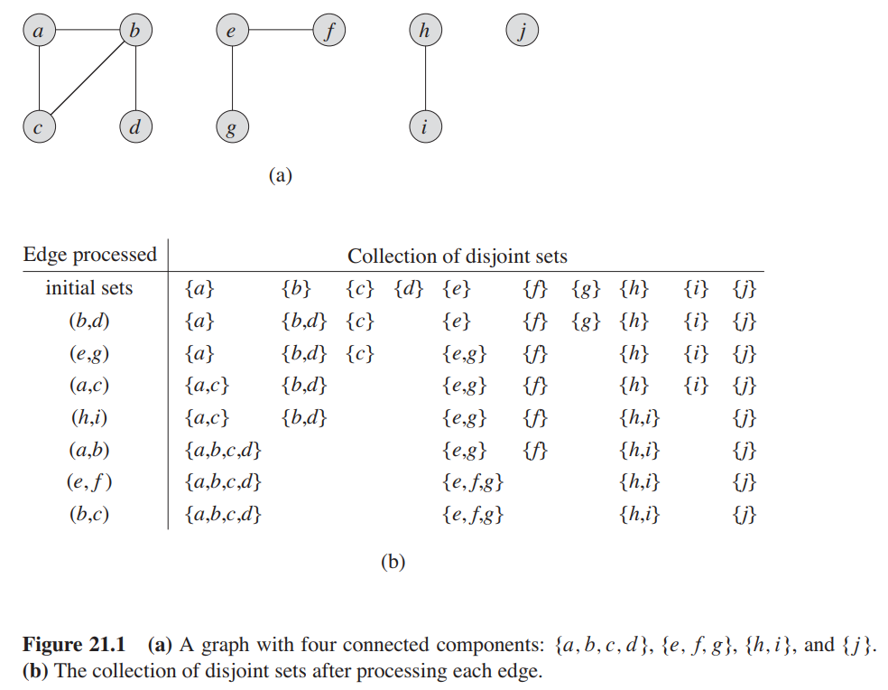
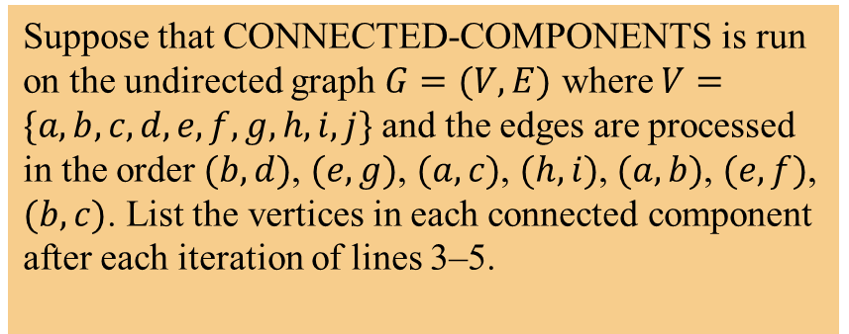
Connected Components
Suppose that CONNECTED-COMPONENTS is run on the undirected graph $G=(V,E)$ where $V=\{a, b,c,d,e,f,g,h,i,j\}$ and the edges are processed in the order $(b,d)$, $(e,g)$, $(a,c)$, $(h,i)$, $(a,b)$, $(e,f)$, $(b,c)$. List the vertices in each connected component after each iteration of lines 3–5.
CONNECTED_COMPONENTS(G):
for each vertex v in V[G] do
MAKE_SET (v)
for each edge (u, v) in E[G] do
if FIND_SET(u) != FIND_SET(v) then
UNION(u, v)
SAME_COMPONENT(u, v):
if FIND_SET(u) == FIND_SET(v) then
return TRUE
else return FALSE

Slide 3
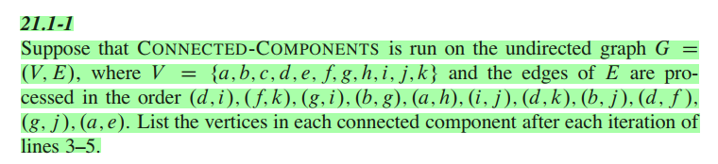
Connected Components

Slide 4
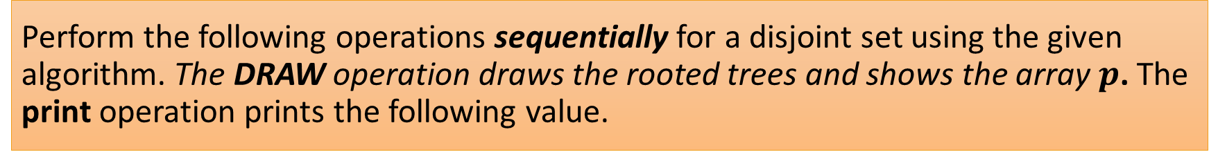
Perform the following operations sequentially for a disjoint set using the given algorithm. The DRAW operation draws the rooted trees and shows the array $p$. The print operation prints the following value.
MakeSet(0)
MakeSet(1)
MakeSet(2)
MakeSet(3)
MakeSet(4)
MakeSet(5)
MakeSet(6)
MakeSet(7)
print(FIND-SET(7))
Draw
UNION(0, 4)
UNION(6, 7)
UNION(7, 2)
print(FIND-SET(7))
UNION(5, 7)
UNION(6, 1)
UNION(4, 3)
print(FIND-SET(6))
Draw

Slide 5

Algorithm for Disjoint-Set Forest
without rank and path compression heuristic
MAKE-SET(x)
p[x]←x
UNION(x, y)
$a$ = FIND-SET(x)
$b$ = FIND-SET(y))
$print(a, b)$
$p\left[a\right]= b$
FIND-SET(x)
if x≠ p[x]
return FIND-SET(p[x])
return p[x]

Slide 6
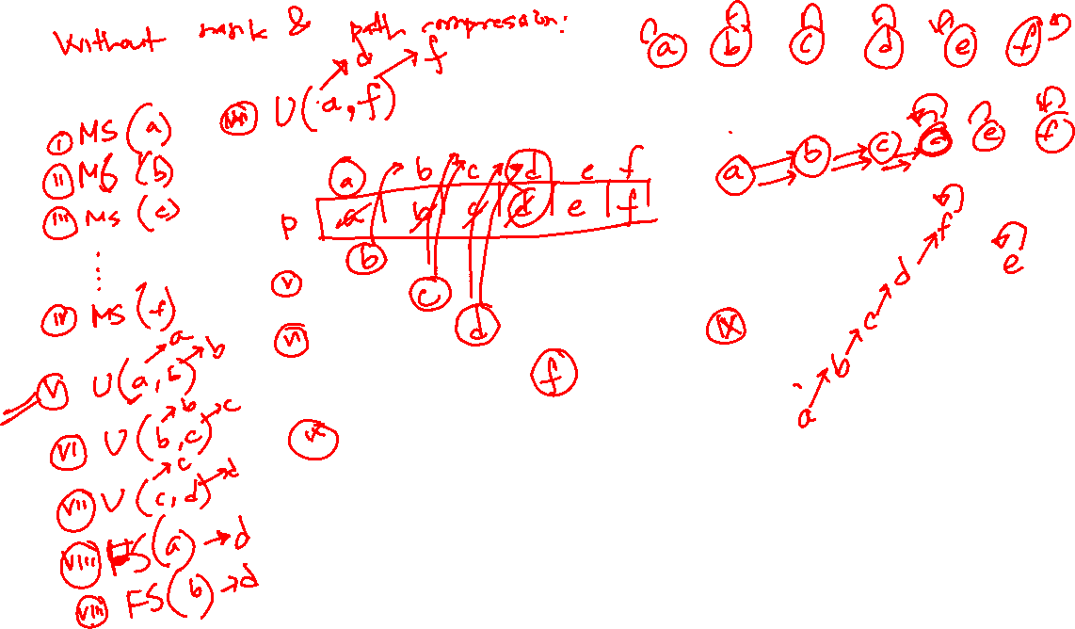

Slide 7
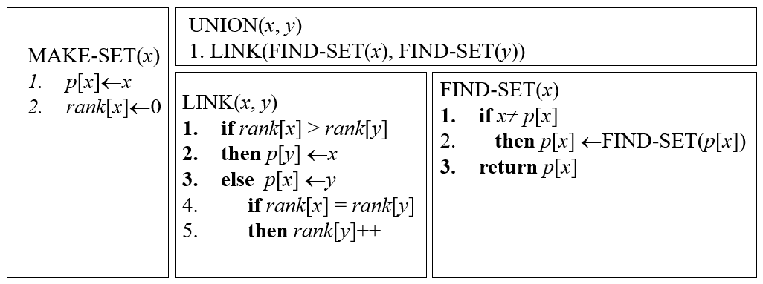
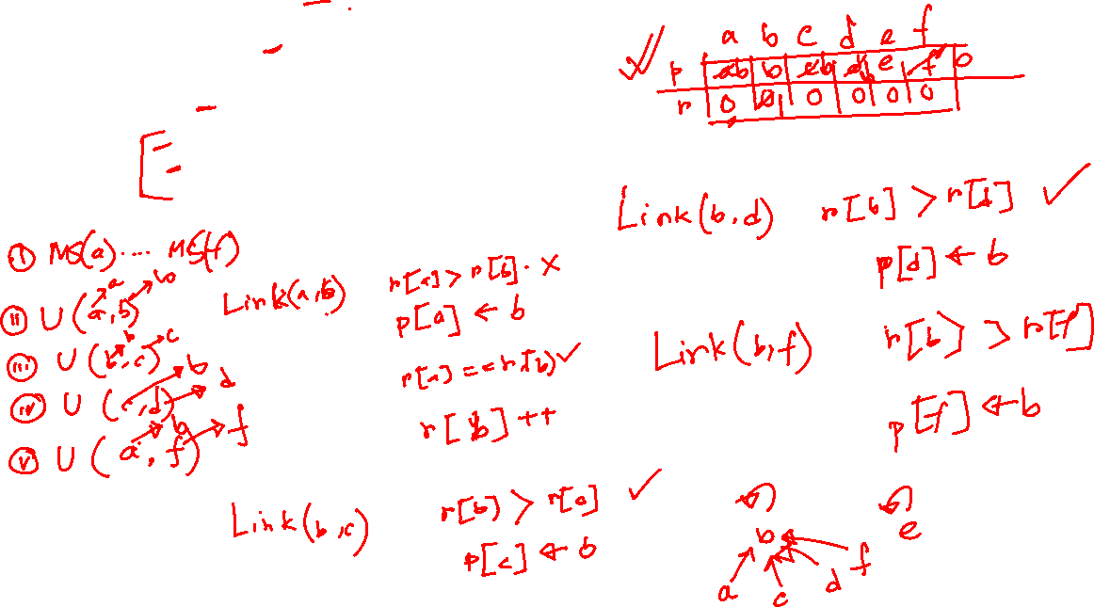

Slide 8
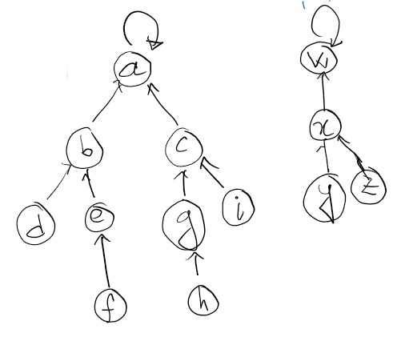
Perform the following operations sequentially on the following disjoint set forest using path compression and union-by-rank heuristic. (a) Find-Set(e) (b) Union(h, y)

Slide 9
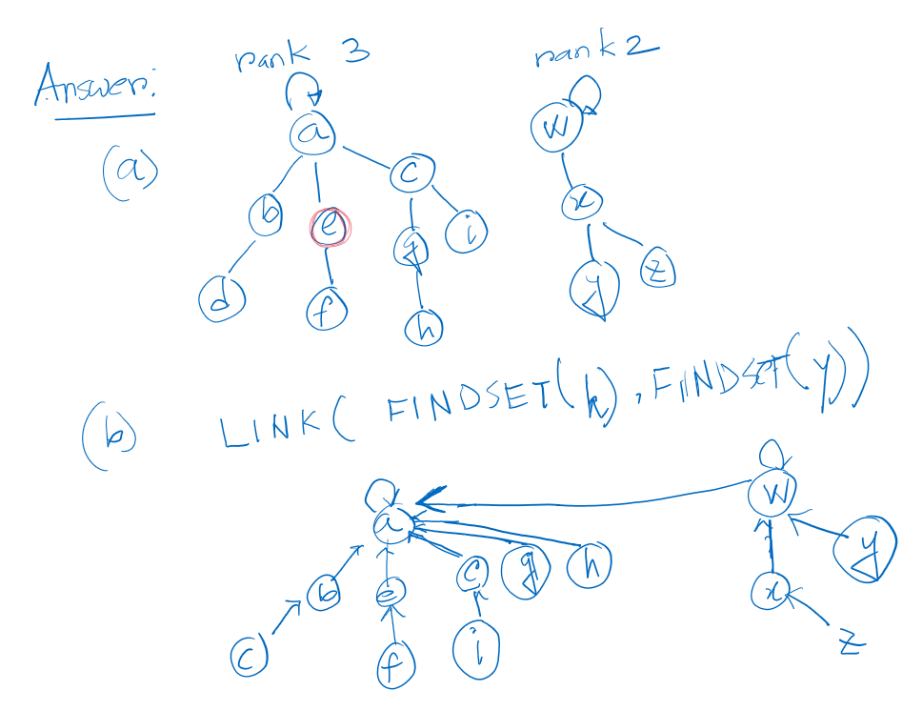
Perform the following operations sequentially on the following disjoint set forest using path compression and union-by-rank heuristic. (a) Find-Set(e) (b) Union(h, y)

